Slide 1
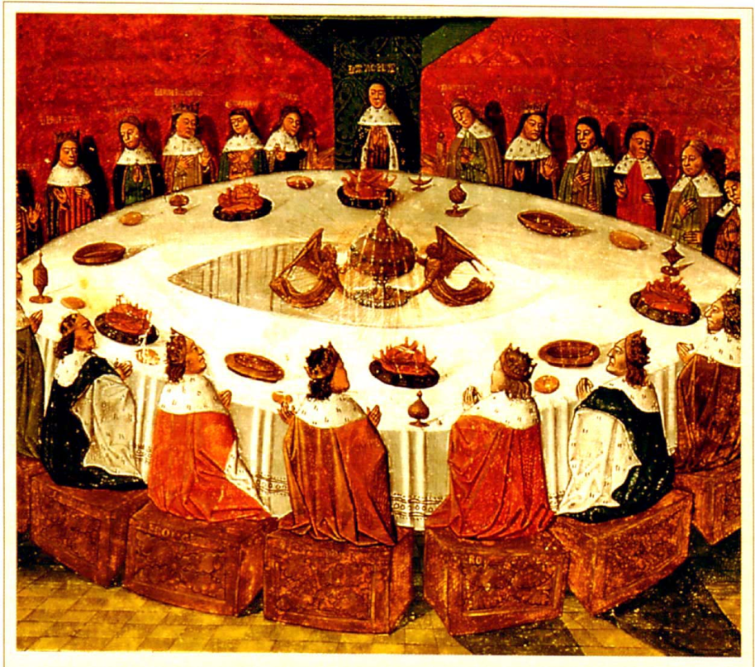
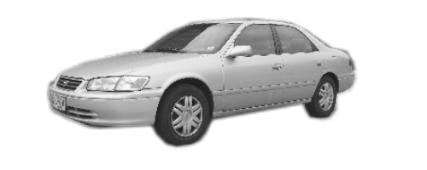
3D object categorization
Courtesy of Prof. Silvio Savarese (U. Michigan, Ann-Arbor)

Slide 2
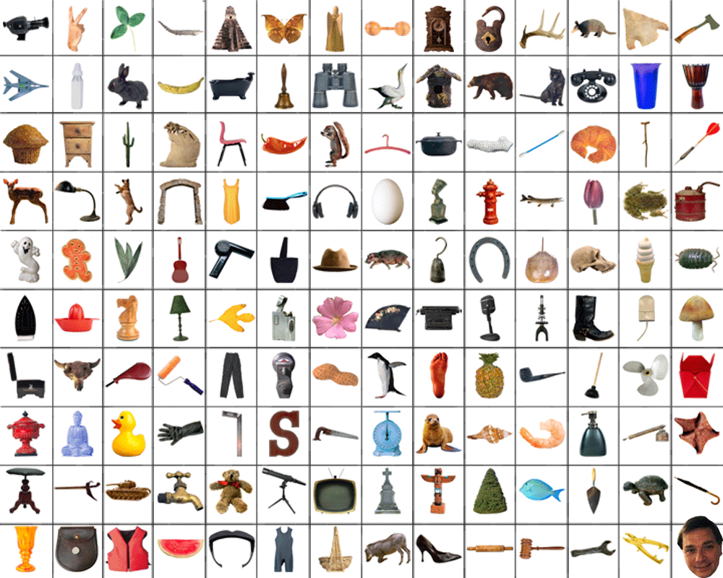
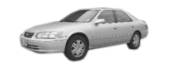

Slide 3

King Arthur and the knights of the Round Table.

Slide 4

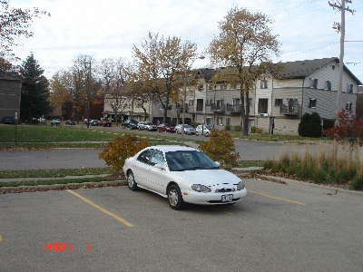
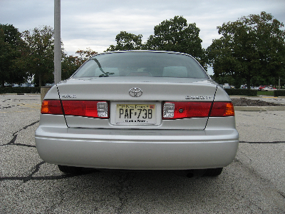
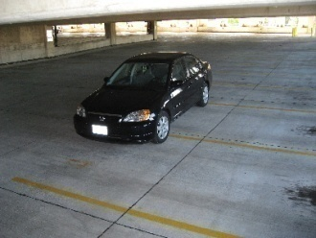
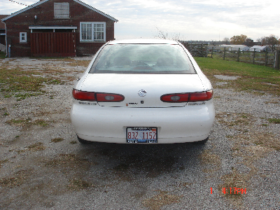
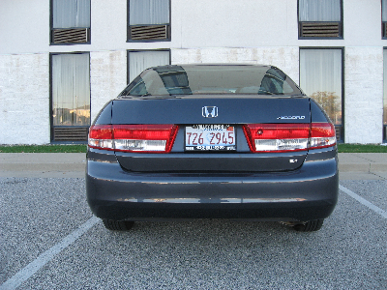
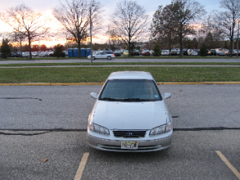
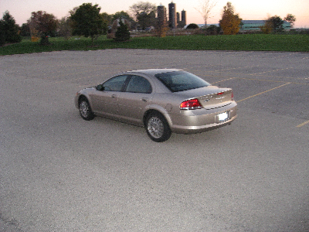
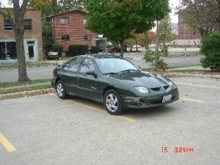
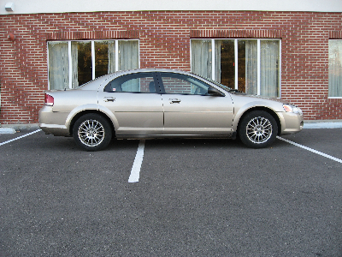
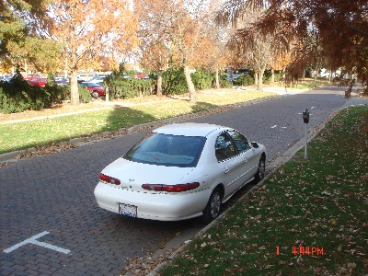
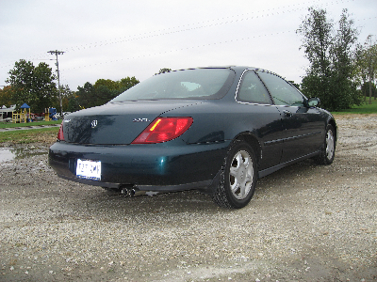
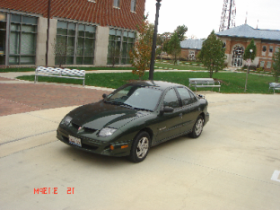
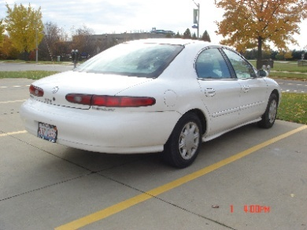
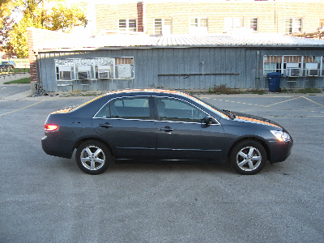
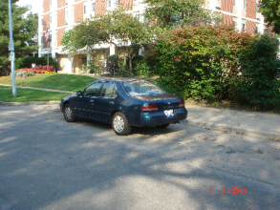
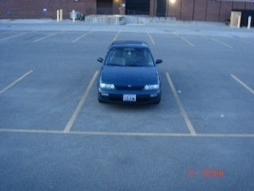
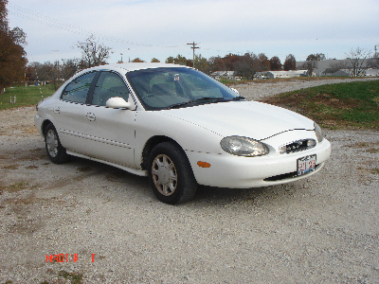
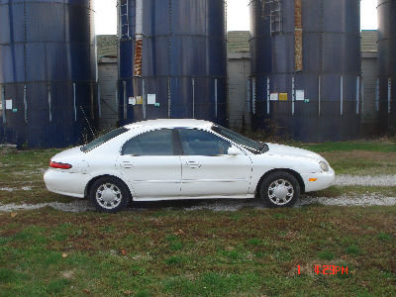
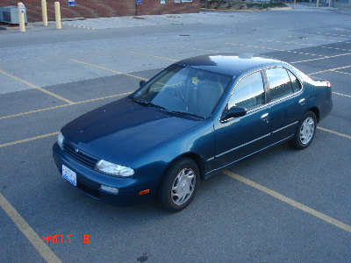
3D Object Categorization
Weber et al. ‘00
Schneiderman et al. ’01
Capel et al ’02
Johnson & Herbert ‘99
Bronstein et al, ‘03
Ruiz-Correa et al. ’03,
Funkhouser et al ’03
Bart et al ‘04
Thomas et al. ‘06
Kushal, et al., ’07
Savarese et al, 07, 08
Chiu et al. ‘07
Hoiem, et al., ’07
Yan, et al. ’07
Notes:
But how can we cope with the fact that in real world, objects are seen under all possible point of views?
This variability is well represented by recent dataset such as pascal, label-me, and our 3D-10 dataset, as we’ll see later in this talk.

Slide 5
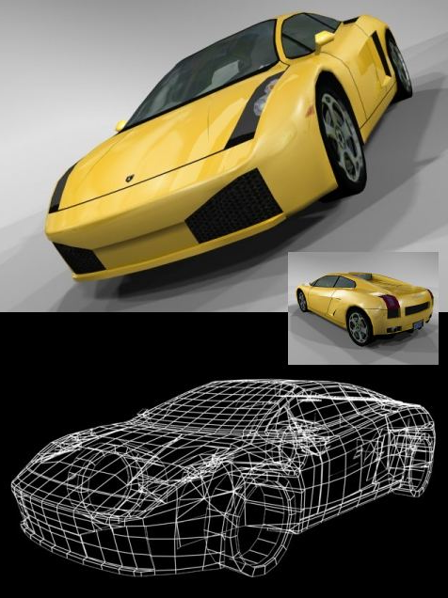
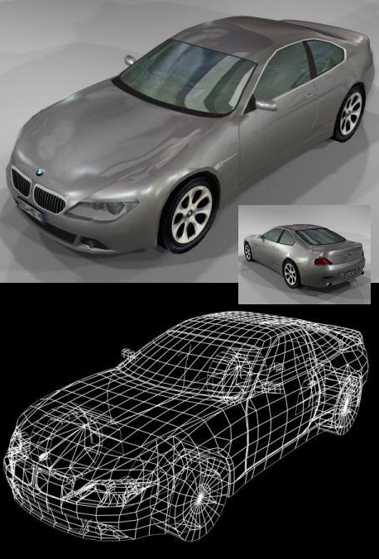

3D Object Categorization
Challenges
- how to model 3D shape variability?
- How to model texture (appearance) variability?
- How to link texture (appearance) across views?

Slide 6
3D Object Categorization
Mixture of 2D single view models
Weber et al. ‘00
Schneiderman et al. ’01
Bart et al. ‘04
Full 3D models
Bronstein et al, ‘03
Ruiz-Correa et al. ’03,
Funkhouser et al ’03
Capel et al ’02
Johnson & Herbert ‘99
Multi-view models
Thomas et al. ‘06
Savarese et al, 07, 08
Chiu et al. ‘07
Hoiem, et al., ’07
Yan, et al. ’07
Kushal, et al., ’07
Liebelt et al 08
Sun, Su, Savarese et al 09a, 09b
Notes:
Recent works have proposed new interesting representations for 3d object categories. In these representations e sparse set of interest points or parts of the objects are linked across views.
No compact representation: the complexity of the model increases with the number of poses in training. not tested on more than 2 categories. We’ll go over a more extensive comparison at the end of this talk.

Slide 7
Overview
Single 3D object recognition
Single view object categorization
3D object categorization

Slide 8


Single 3D object recognition
Edelman et al. ’91
Ullman & Barsi, ’91
Rothwell ‘92
Linderberg, ’94
Murase & Nayar ‘94
Zhang et al ’95
Schmid & Mohr, ‘96
Schiele & Crowley, ’96
Lowe, ‘99
Jacob & Barsi, ‘99
Rothganger et al., ‘04
Ferrari et al, ’05
Brown & Lowe ’05
Snavely et al ’06
Yin & Collins, ‘07
Ballard, ‘81
Grimson & L.-Perez, ‘87
Lowe, ’87
Notes:
If we only consider images of the same instance, the problem is that of recognizing single 3D objects and their poses.
This problem has received a lot of attention, from the 80s to more recent work by Lowe, Rothganger and colleagues and Ferrari and colleagues.

Slide 9
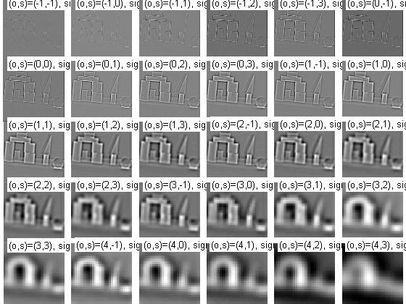
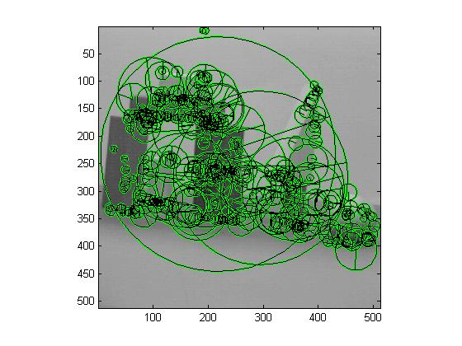
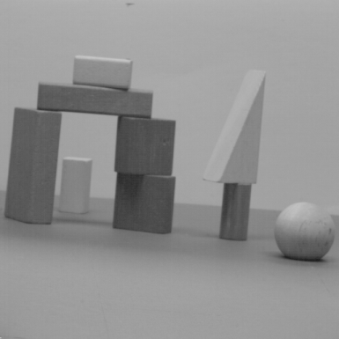
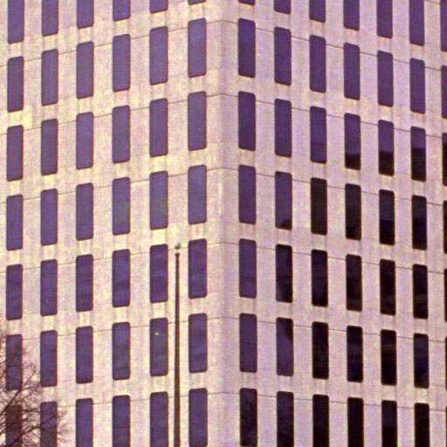
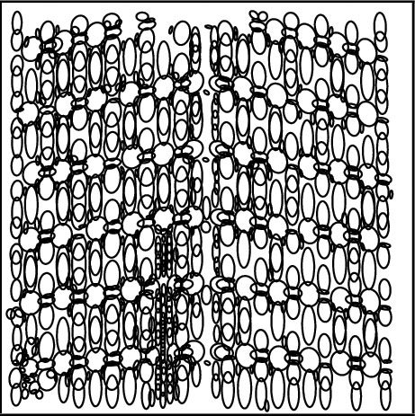
Difference of Gaussian (DOG): used in Lowe 99, Brown et al ‘05
Courtesy of D. Lowe
Harris-Laplace: used in Rothganger et al. ‘06
Laplacian: used in Lazebnik et al. ‘04
Courtesy of Rothganger et al
Notes:
Classic methods didn’t allow for as much variance in source images due to relative non-invariance of detection and description.
Not going to go over this in depth
DoG detects gradient blobs

Slide 10
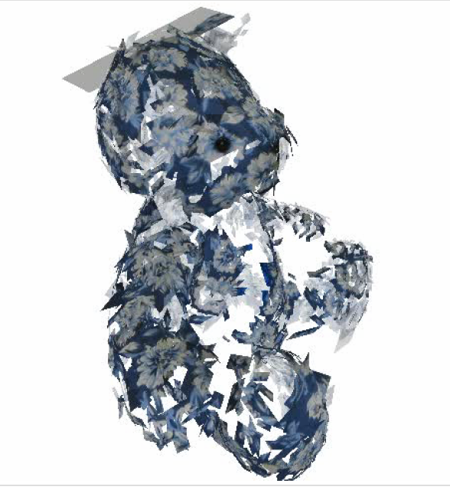
Object representation:
Collection of patches in 3D
Rothganger et al. ’06
x,y,z +
h,v +
descriptor
Courtesy of Rothganger et al

Slide 11
Model learning
Rothganger et al. ‘03 ’06
Build a 3D model:
N images of object from N different view points
Match key points between consecutive views
[ create sample set]
Use affine structure from motion to compute 3D location and orientation + camera locations [RANSAC]
Find connected components
Use bundle adjustment to refine model
Upgrade model to Euclidean assuming zero skew and square pixels
Notes:
TRACKING ALONG A SINGLE PAIR OF SUBSEQUENTLY-SAMPLED FRAMES, VIDEO SHOWN LATER
Note Rothganger results only show 20 of hundreds of patches

Slide 12
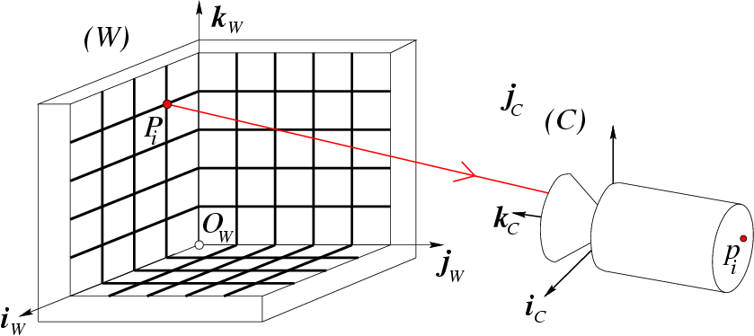
Recognition
[Rothganger et al. ‘03 ’06]
1. Find matches between model and test image features

Slide 13
Recognition
[Rothganger et al. ‘03 ’06]
1. Find matches between model and test image features
2. Generate hypothesis:
Compute transformation M from N matches (N=2; affine camera; affine key points)
3. Model verification
Use M to project other matched 3D model features into test image
Compute residual = D(projections, measurements)

Slide 14
Recognition
[Rothganger et al. ‘03 ’06]
Goal:
Estimate (fit) the best M in presence of outliers

Slide 15
3D Object Categorization
Mixture of 2D single view models
Weber et al. ‘00
Schneiderman et al. ’01
Bart et al. ‘04
Full 3D models
Bronstein et al, ‘03
Ruiz-Correa et al. ’03,
Funkhouser et al ’03
Capel et al ’02
Johnson & Herbert ‘99
Multi-view models
Thomas et al. ‘06
Savarese et al, 07, 08
Chiu et al. ‘07
Hoiem, et al., ’07
Yan, et al. ’07
Kushal, et al., ’07
Liebelt et al 08
Sun et al 08
Notes:
Recent works have proposed new interesting representations for 3d object categories. In these representations e sparse set of interest points or parts of the objects are linked across views.
No compact representation: the complexity of the model increases with the number of poses in training. not tested on more than 2 categories. We’ll go over a more extensive comparison at the end of this talk.

Slide 16
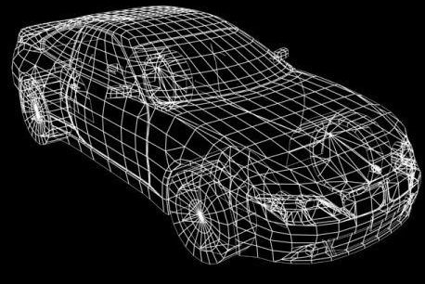
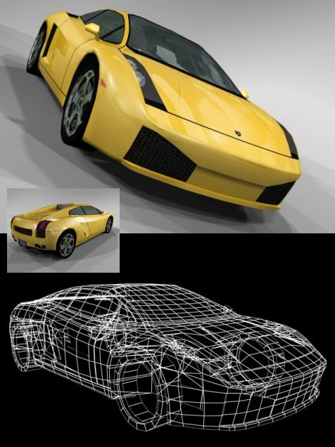
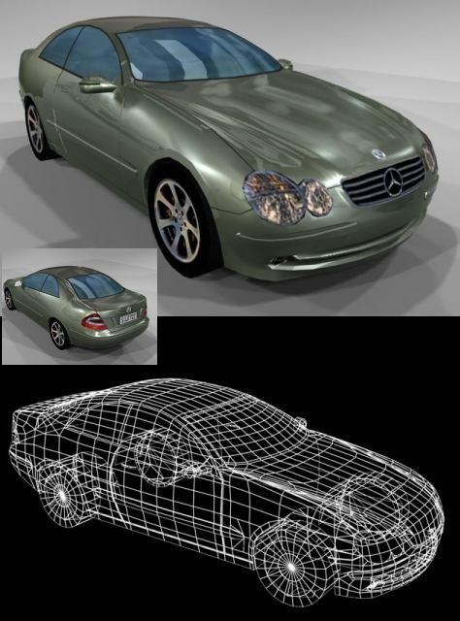
Full 3D models
Bronstein et al, ‘03
Ruiz-Correa et al. ’03,
Funkhouser et al ’03
Kazhdan et al.03
Osada et al ‘02
Capel et al ’02
Johnson & Herbert ’99
Amberg et al ‘08
3D model
instance
3D category
model
…
3D model
instance
A 3D model category is built from a collection of 3D range data or CAD models
Notes:
Drawback: How to handle appearance?

Slide 17
Shape distributions
Osada et al 02
Spherical harmonics
Kazhdan et al. 03

Slide 18
Full 3D models
Bronstein et al, ‘03
Ruiz-Correa et al. ’03,
Funkhouser et al ’03
Kazhdan et al.03
Osada et al ‘02
Capel et al ’02
Johnson & Herbert ’99
Amberg et al ‘08
3D model
instance
3D category
model
…
3D model
instance
A 3D model category is built from a collection of 3D range data or CAD models
Build a 3d model is expensive
Difficult to incorporate appearance information
- Need to cope with 3D alignment (orientation, scale, etc…)
Notes:
Drawback: How to handle appearance?

Slide 19
3D Object Categorization
Mixture of 2D single view models
Weber et al. ‘00
Schneiderman et al. ’01
Bart et al. ‘04
Full 3D models
Bronstein et al, ‘03
Ruiz-Correa et al. ’03,
Funkhouser et al ’03
Capel et al ’02
Johnson & Herbert ‘99
Multi-view models
Thomas et al. ‘06
Savarese et al, 07, 08
Chiu et al. ‘07
Hoiem, et al., ’07
Yan, et al. ’07
Kushal, et al., ’07
Liebelt et al 08
Sun et al 08
Notes:
Recent works have proposed new interesting representations for 3d object categories. In these representations e sparse set of interest points or parts of the objects are linked across views.
No compact representation: the complexity of the model increases with the number of poses in training. not tested on more than 2 categories. We’ll go over a more extensive comparison at the end of this talk.

Slide 20
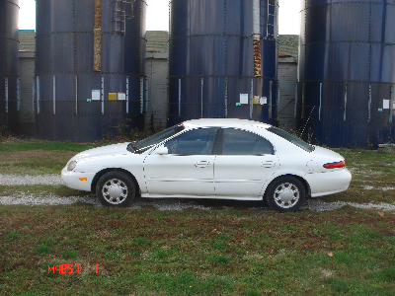
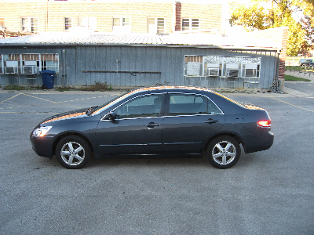

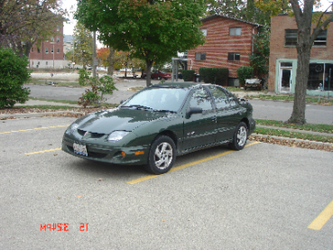

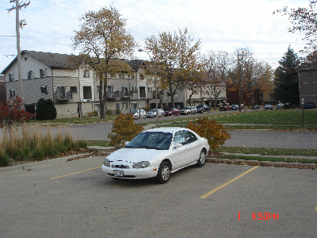
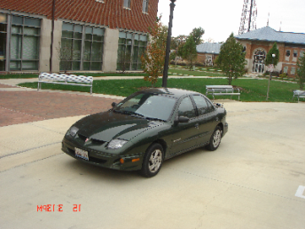
Multi-view models
…
…
3D Category
model
…
Sparse set of interest points or parts of the objects are linked across views.
Notes:
One solution for this challenge is to consider methods based on mixture of 2D single view models. Each single view model is learnt from a set of images of an object under the same pose. Then the final model of the 3d object is a mixture of these.
One key limitation of mixture models is that they don’t really capture the intrinsic nature of a three-dimensional object category.
It is unsatisfying that different 3D poses of the same object category model are completely independent. In particular, there is no sense of correspondences of parts of the objects under the 3D transformations.
Ultimately, mixture models fails to capture the intrinsic multi-view nature of object categories
% Each is these submodel can be successful in taking account varibility due to occlusions, lighting , intra-class

Slide 21
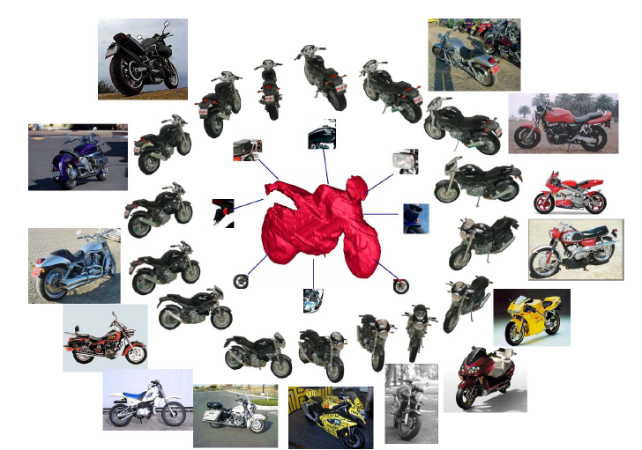
Multi-view models by rough 3d shapes
Yan, et al. ’07

Slide 22
Multi-view models by rough 3d shapes
Hoiem, et al., ’07
Notes:
3D LayoutCRF Part Assignment. During initialization,
we use a rough 3D model (top) to consistently assign the
same physical part across different instances in different viewpoints.
We then learn appearance models over those parts and use
them to relabel the parts (bottom), allowing the part grid to deform
slightly to better fit each training instance.

Slide 23
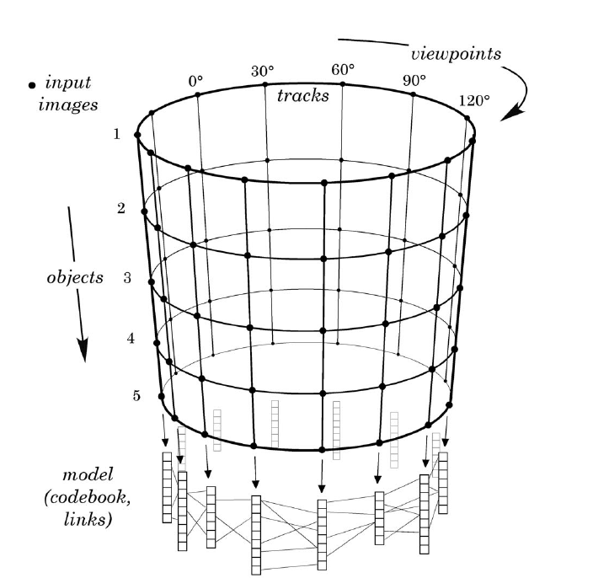
Multi-view models by ISM representations
[Thomas et al. ’06]
‘Courtesy of Thomas et al. 06
Notes:
Visual representation of our multi-view model. Only
viewpoints lying on a circle around the object are shown. However,
the proposed method supports the general case of viewpoints
distributed over the whole viewing sphere.

Slide 24
Multi-view models by ISM representations
[Thomas et al. ’06]
…
…
Multi-view
model
…
Sparse set of interest points or parts of the objects are linked across views.
Notes:
One solution for this challenge is to consider methods based on mixture of 2D single view models. Each single view model is learnt from a set of images of an object under the same pose. Then the final model of the 3d object is a mixture of these.
One key limitation of mixture models is that they don’t really capture the intrinsic nature of a three-dimensional object category.
It is unsatisfying that different 3D poses of the same object category model are completely independent. In particular, there is no sense of correspondences of parts of the objects under the 3D transformations.
Ultimately, mixture models fails to capture the intrinsic multi-view nature of object categories
% Each is these submodel can be successful in taking account varibility due to occlusions, lighting , intra-class

Slide 25
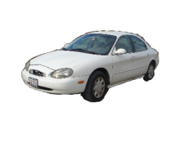
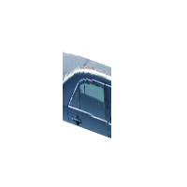
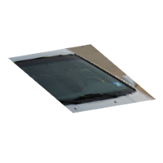
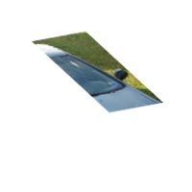
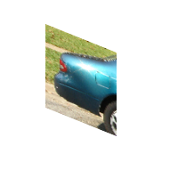
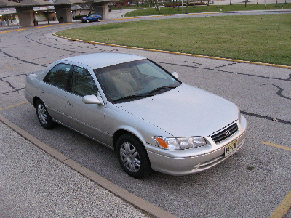
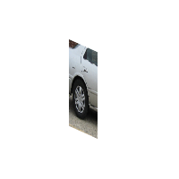
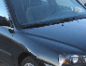





A unified framework for 3D object
detection, pose classification, pose synthesis
Savarese, Fei-Fei, ICCV 07
Savarese, Fei-Fei, ECCV 08
Sun, Su, Savarese, Fei-Fei, CVPR 09
Su, Sun, Fei-Fei, Savarese, ICCV 09
Canonical parts captures diagnostic appearance information
2d ½ structure linking parts via weak geometry
Notes:
In this work we propose a New representation for object categorization that captures the intrisic multi-view nature of object categories
Key facts of our representation are
% Hierachical, that is, we go from features (key points) into parts, and then from parts to the 3d object model]
We define CP as building blocks of our representation. these are the stable and diagnostic parts of objects
Linkage structure which connect canonical parts through a weak 3D geometrical transformation based on homographic transformations
% The canonical parts are linked via homographic transformations across multiple views. This give rise to a linkage structure. The linkage structure along % with the CP gives rise to our object category model.
Notice that we are not aiming at representing 3d object category by a 3d full reconstruction
but rather using diagnostic appearance as well as weak but crucial geometry
% We want to emphasize that we are not proposing a 3D reconstruction of object categories, but rather
% a representation for 3D object categorization which is encoding both diagnostic appearance as well as weak but crucial geometry.
Full 3d object model seems to unsuitable to handle intra-class variability
Encode weak yet crucial geometrical constraints
This is captured by the homographics transformations between canonical parts
Our representation does not provide a full 3d reconstruction of the object - we believe that a 3D reconstruction is a too rigid representation for modeling object categories and their intraclass variability. Our representation rather uses diagnostic appearance as well as weak but crucial geometry.
% Canonical parts belonging to the same planes share their pose. Canonical parts that do not belong to the same plane, correspond to different poses of the 3d object.
Our representation is compact thanks to the introduction of canonical parts as opposed to thomas and kushal
Our representation is hierarchical: as we’ll see later, canonical part are described by distribution of features. Thus, the 3D object model is described by a distribution of canonical part organized in a linkage structure.

Slide 26







Canonical parts
If physical part is planar, canonical part is stable point on the manifold
Canonical part can be computed from connected component of parts
connected
component of parts
Notes:
Before we go into details of model building and recognition, we introduce the concept of CP
Let’s consider an object class – a car – within a viewing sphere. Let’s consider a physical part attached to the car. For instance the region including rear lights and bumper. As the observer moves on the viewing sphere, this part will show a different appearance. For instance, if the observer is here, the part will appear this way.
The set of locations from which the part is visible by the observer defines this green manifold on the viewing sphere.
So how do we represent this rear-light-bumper part?
% We could collect all its views on this manifold. But this is very expensive and grows with the # of views.
One way is to select points on this manifold and represent the part as the collections of the corresponding view.
But this is very expensive and grows with the # of views.
%In our work, we select one point on this manifold to represent this part. We call this the CP. We will show later how we pick this point – in short, it’s where this part is %viewed most frontally.
In our work we represent the part by selecting one point on this manifold. That is the point where part is viewed the most frontally. The corresponding view gives rise to the canonical part.
The CP provides a conpact and stable representation the object part across multiple views and instances.
In fact, we consider the manifold on the viewing sphere that correspong to the collections of position from
Which the physical part is visible, it is easy to show that a canonical part will be located in point of stability in the manifold.
Thus, it captures diagnostic information of the object
<add the manifold intuition>!!!!
CP is stable: from the set of positions in the wieving sphere we can always converge toward the canonical position

Slide 27







Canonical parts
connected
component of parts
Notes:
This is another example of the wind-shield part of a car and its corresponding canonical part on the viewing sphere.

Slide 28









Linkage structure
Notes:
Another key point of our representation is the linkage structure. The linkage structure connect canonical parts.
Pairs of canonical parts are then linked if they can both visible at the same.
The linkage indicates the relative change of pose of a canonical part given the other. This change of pose is quantified by an homographic transformation
This gives rise to a linkage structure connecting canonical parts which is our object representation

Slide 29







Object Recognition
Query image
model
Algorithm
1. Find hypotheses of canonical parts consistent with a given pose
Notes:
In recognition we want to match the query image with best object class model.
Given a model, we first find hypotheses of canonical parts consistent with a certain pose.
% For this set of canonical parts they all consistent with this particular pose , in other words, given this pose they can all be observed frontally.

Slide 30




Object Recognition
Query image
model
Algorithm
1. Find hypotheses of canonical parts consistent with a given pose
2. Infer position and pose of other canonical parts
Notes:
Now, given these CP and this particular pose, we can infer the appearance, pose and position of the other CP (this information is encoded in part appearance and H transformation of the object class model).

Slide 31



Object Recognition
Query image
model
Algorithm
1. Find hypotheses of canonical parts consistent with a given pose
2. Infer position and pose of other canonical parts

Slide 32
Object Recognition
Query image
model
Algorithm
1. Find hypotheses of canonical parts consistent with a given pose
2. Infer position and pose of other canonical parts
3. Optimize over E, G and s to find best combination of hypothesis
→ error
Notes:
An optimization process finds the best combination of hypothesis over appearance and geometrical similarity. The output is an error score.
The operation is repeated for all set of possible set of CP and their consistent views, for all object class models.
This gives a residual error that can be used to rank the quality of the match between the query image and a model and a pose
Finally, the configuration that gives rise to the lowest error score indicates the winning category label and pose label

Slide 33
A unified framework for 3D object
detection, pose classification, pose synthesis
Savarese, Fei-Fei, ICCV 07
Savarese, Fei-Fei, ECCV 08
Sun, Su, Savarese, Fei-Fei, CVPR 09
Su, Sun, Fei-Fei, Savarese, ICCV 09
Probabilistic generative part-based model
Dense Multi-view representation on the viewing sphere
Notes:
In this work we propose a New representation for object categorization that captures the intrisic multi-view nature of object categories
Key facts of our representation are
% Hierachical, that is, we go from features (key points) into parts, and then from parts to the 3d object model]
We define CP as building blocks of our representation. these are the stable and diagnostic parts of objects
Linkage structure which connect canonical parts through a weak 3D geometrical transformation based on homographic transformations
% The canonical parts are linked via homographic transformations across multiple views. This give rise to a linkage structure. The linkage structure along % with the CP gives rise to our object category model.
Notice that we are not aiming at representing 3d object category by a 3d full reconstruction
but rather using diagnostic appearance as well as weak but crucial geometry
% We want to emphasize that we are not proposing a 3D reconstruction of object categories, but rather
% a representation for 3D object categorization which is encoding both diagnostic appearance as well as weak but crucial geometry.
Full 3d object model seems to unsuitable to handle intra-class variability
Encode weak yet crucial geometrical constraints
This is captured by the homographics transformations between canonical parts
Our representation does not provide a full 3d reconstruction of the object - we believe that a 3D reconstruction is a too rigid representation for modeling object categories and their intraclass variability. Our representation rather uses diagnostic appearance as well as weak but crucial geometry.
% Canonical parts belonging to the same planes share their pose. Canonical parts that do not belong to the same plane, correspond to different poses of the 3d object.
Our representation is compact thanks to the introduction of canonical parts as opposed to thomas and kushal
Our representation is hierarchical: as we’ll see later, canonical part are described by distribution of features. Thus, the 3D object model is described by a distribution of canonical part organized in a linkage structure.

Slide 34
A unified framework for 3D object
detection, pose classification, pose synthesis
Savarese, Fei-Fei, ICCV 07
Savarese, Fei-Fei, ECCV 08
Sun, Su, Savarese, Fei-Fei, CVPR 09
Su, Sun, Fei-Fei, Savarese, ICCV 09
10:50am Thursday, Oct 1, Oral session 9
H. Su*, M. Sun*, L. Fei-Fei, S. Savarese, Learning a Dense Multi-view Representation for Detection, Viewpoint Classification and Synthesis of Object Categories.
Notes:
In this work we propose a New representation for object categorization that captures the intrisic multi-view nature of object categories
Key facts of our representation are
% Hierachical, that is, we go from features (key points) into parts, and then from parts to the 3d object model]
We define CP as building blocks of our representation. these are the stable and diagnostic parts of objects
Linkage structure which connect canonical parts through a weak 3D geometrical transformation based on homographic transformations
% The canonical parts are linked via homographic transformations across multiple views. This give rise to a linkage structure. The linkage structure along % with the CP gives rise to our object category model.
Notice that we are not aiming at representing 3d object category by a 3d full reconstruction
but rather using diagnostic appearance as well as weak but crucial geometry
% We want to emphasize that we are not proposing a 3D reconstruction of object categories, but rather
% a representation for 3D object categorization which is encoding both diagnostic appearance as well as weak but crucial geometry.
Full 3d object model seems to unsuitable to handle intra-class variability
Encode weak yet crucial geometrical constraints
This is captured by the homographics transformations between canonical parts
Our representation does not provide a full 3d reconstruction of the object - we believe that a 3D reconstruction is a too rigid representation for modeling object categories and their intraclass variability. Our representation rather uses diagnostic appearance as well as weak but crucial geometry.
% Canonical parts belonging to the same planes share their pose. Canonical parts that do not belong to the same plane, correspond to different poses of the 3d object.
Our representation is compact thanks to the introduction of canonical parts as opposed to thomas and kushal
Our representation is hierarchical: as we’ll see later, canonical part are described by distribution of features. Thus, the 3D object model is described by a distribution of canonical part organized in a linkage structure.

Slide 35
A unified framework for 3D object
detection, pose classification, pose synthesis
Su, Sun, Fei-Fei, Savarese, ICCV 09
Notes:
In this work we propose a New representation for object categorization that captures the intrisic multi-view nature of object categories
Key facts of our representation are
% Hierachical, that is, we go from features (key points) into parts, and then from parts to the 3d object model]
We define CP as building blocks of our representation. these are the stable and diagnostic parts of objects
Linkage structure which connect canonical parts through a weak 3D geometrical transformation based on homographic transformations
% The canonical parts are linked via homographic transformations across multiple views. This give rise to a linkage structure. The linkage structure along % with the CP gives rise to our object category model.
Notice that we are not aiming at representing 3d object category by a 3d full reconstruction
but rather using diagnostic appearance as well as weak but crucial geometry
% We want to emphasize that we are not proposing a 3D reconstruction of object categories, but rather
% a representation for 3D object categorization which is encoding both diagnostic appearance as well as weak but crucial geometry.
Full 3d object model seems to unsuitable to handle intra-class variability
Encode weak yet crucial geometrical constraints
This is captured by the homographics transformations between canonical parts
Our representation does not provide a full 3d reconstruction of the object - we believe that a 3D reconstruction is a too rigid representation for modeling object categories and their intraclass variability. Our representation rather uses diagnostic appearance as well as weak but crucial geometry.
% Canonical parts belonging to the same planes share their pose. Canonical parts that do not belong to the same plane, correspond to different poses of the 3d object.
Our representation is compact thanks to the introduction of canonical parts as opposed to thomas and kushal
Our representation is hierarchical: as we’ll see later, canonical part are described by distribution of features. Thus, the 3D object model is described by a distribution of canonical part organized in a linkage structure.

Slide 36


A unified framework for 3D object
detection, pose classification, pose synthesis
Su, Sun, Fei-Fei, Savarese, ICCV 09
Notes:
In this work we propose a New representation for object categorization that captures the intrisic multi-view nature of object categories
Key facts of our representation are
% Hierachical, that is, we go from features (key points) into parts, and then from parts to the 3d object model]
We define CP as building blocks of our representation. these are the stable and diagnostic parts of objects
Linkage structure which connect canonical parts through a weak 3D geometrical transformation based on homographic transformations
% The canonical parts are linked via homographic transformations across multiple views. This give rise to a linkage structure. The linkage structure along % with the CP gives rise to our object category model.
Notice that we are not aiming at representing 3d object category by a 3d full reconstruction
but rather using diagnostic appearance as well as weak but crucial geometry
% We want to emphasize that we are not proposing a 3D reconstruction of object categories, but rather
% a representation for 3D object categorization which is encoding both diagnostic appearance as well as weak but crucial geometry.
Full 3d object model seems to unsuitable to handle intra-class variability
Encode weak yet crucial geometrical constraints
This is captured by the homographics transformations between canonical parts
Our representation does not provide a full 3d reconstruction of the object - we believe that a 3D reconstruction is a too rigid representation for modeling object categories and their intraclass variability. Our representation rather uses diagnostic appearance as well as weak but crucial geometry.
% Canonical parts belonging to the same planes share their pose. Canonical parts that do not belong to the same plane, correspond to different poses of the 3d object.
Our representation is compact thanks to the introduction of canonical parts as opposed to thomas and kushal
Our representation is hierarchical: as we’ll see later, canonical part are described by distribution of features. Thus, the 3D object model is described by a distribution of canonical part organized in a linkage structure.

Slide 37

A unified framework for 3D object
detection, pose classification, pose synthesis
Su, Sun, Fei-Fei, Savarese, ICCV 09
Notes:
In this work we propose a New representation for object categorization that captures the intrisic multi-view nature of object categories
Key facts of our representation are
% Hierachical, that is, we go from features (key points) into parts, and then from parts to the 3d object model]
We define CP as building blocks of our representation. these are the stable and diagnostic parts of objects
Linkage structure which connect canonical parts through a weak 3D geometrical transformation based on homographic transformations
% The canonical parts are linked via homographic transformations across multiple views. This give rise to a linkage structure. The linkage structure along % with the CP gives rise to our object category model.
Notice that we are not aiming at representing 3d object category by a 3d full reconstruction
but rather using diagnostic appearance as well as weak but crucial geometry
% We want to emphasize that we are not proposing a 3D reconstruction of object categories, but rather
% a representation for 3D object categorization which is encoding both diagnostic appearance as well as weak but crucial geometry.
Full 3d object model seems to unsuitable to handle intra-class variability
Encode weak yet crucial geometrical constraints
This is captured by the homographics transformations between canonical parts
Our representation does not provide a full 3d reconstruction of the object - we believe that a 3D reconstruction is a too rigid representation for modeling object categories and their intraclass variability. Our representation rather uses diagnostic appearance as well as weak but crucial geometry.
% Canonical parts belonging to the same planes share their pose. Canonical parts that do not belong to the same plane, correspond to different poses of the 3d object.
Our representation is compact thanks to the introduction of canonical parts as opposed to thomas and kushal
Our representation is hierarchical: as we’ll see later, canonical part are described by distribution of features. Thus, the 3D object model is described by a distribution of canonical part organized in a linkage structure.

Slide 38

A unified framework for 3D object
detection, pose classification, pose synthesis
Su, Sun, Fei-Fei, Savarese, ICCV 09
Notes:
In this work we propose a New representation for object categorization that captures the intrisic multi-view nature of object categories
Key facts of our representation are
% Hierachical, that is, we go from features (key points) into parts, and then from parts to the 3d object model]
We define CP as building blocks of our representation. these are the stable and diagnostic parts of objects
Linkage structure which connect canonical parts through a weak 3D geometrical transformation based on homographic transformations
% The canonical parts are linked via homographic transformations across multiple views. This give rise to a linkage structure. The linkage structure along % with the CP gives rise to our object category model.
Notice that we are not aiming at representing 3d object category by a 3d full reconstruction
but rather using diagnostic appearance as well as weak but crucial geometry
% We want to emphasize that we are not proposing a 3D reconstruction of object categories, but rather
% a representation for 3D object categorization which is encoding both diagnostic appearance as well as weak but crucial geometry.
Full 3d object model seems to unsuitable to handle intra-class variability
Encode weak yet crucial geometrical constraints
This is captured by the homographics transformations between canonical parts
Our representation does not provide a full 3d reconstruction of the object - we believe that a 3D reconstruction is a too rigid representation for modeling object categories and their intraclass variability. Our representation rather uses diagnostic appearance as well as weak but crucial geometry.
% Canonical parts belonging to the same planes share their pose. Canonical parts that do not belong to the same plane, correspond to different poses of the 3d object.
Our representation is compact thanks to the introduction of canonical parts as opposed to thomas and kushal
Our representation is hierarchical: as we’ll see later, canonical part are described by distribution of features. Thus, the 3D object model is described by a distribution of canonical part organized in a linkage structure.

Slide 39

A unified framework for 3D object
detection, pose classification, pose synthesis
Su, Sun, Fei-Fei, Savarese, ICCV 09
Notes:
In this work we propose a New representation for object categorization that captures the intrisic multi-view nature of object categories
Key facts of our representation are
% Hierachical, that is, we go from features (key points) into parts, and then from parts to the 3d object model]
We define CP as building blocks of our representation. these are the stable and diagnostic parts of objects
Linkage structure which connect canonical parts through a weak 3D geometrical transformation based on homographic transformations
% The canonical parts are linked via homographic transformations across multiple views. This give rise to a linkage structure. The linkage structure along % with the CP gives rise to our object category model.
Notice that we are not aiming at representing 3d object category by a 3d full reconstruction
but rather using diagnostic appearance as well as weak but crucial geometry
% We want to emphasize that we are not proposing a 3D reconstruction of object categories, but rather
% a representation for 3D object categorization which is encoding both diagnostic appearance as well as weak but crucial geometry.
Full 3d object model seems to unsuitable to handle intra-class variability
Encode weak yet crucial geometrical constraints
This is captured by the homographics transformations between canonical parts
Our representation does not provide a full 3d reconstruction of the object - we believe that a 3D reconstruction is a too rigid representation for modeling object categories and their intraclass variability. Our representation rather uses diagnostic appearance as well as weak but crucial geometry.
% Canonical parts belonging to the same planes share their pose. Canonical parts that do not belong to the same plane, correspond to different poses of the 3d object.
Our representation is compact thanks to the introduction of canonical parts as opposed to thomas and kushal
Our representation is hierarchical: as we’ll see later, canonical part are described by distribution of features. Thus, the 3D object model is described by a distribution of canonical part organized in a linkage structure.

Slide 40
A unified framework for 3D object
detection, pose classification, pose synthesis
 | Single view | Mixture/ Multi-view | Sav. et al, 07 | Morphing model (Su, Sun, et al. 09)
View point invariant | X | √ | √ | √
No supervision | √ | X | X all views all instances available | √
# Categories | ~300 | 2 | 8 | 16
Share information across views | X | √ | √ | √
View synthesis | X | X | X | √
Pose estimation | √ | X | √ | √
View point
Notes:
In this work we propose a New representation for object categorization that captures the intrisic multi-view nature of object categories
Key facts of our representation are
% Hierachical, that is, we go from features (key points) into parts, and then from parts to the 3d object model]
We define CP as building blocks of our representation. these are the stable and diagnostic parts of objects
Linkage structure which connect canonical parts through a weak 3D geometrical transformation based on homographic transformations
% The canonical parts are linked via homographic transformations across multiple views. This give rise to a linkage structure. The linkage structure along % with the CP gives rise to our object category model.
Notice that we are not aiming at representing 3d object category by a 3d full reconstruction
but rather using diagnostic appearance as well as weak but crucial geometry
% We want to emphasize that we are not proposing a 3D reconstruction of object categories, but rather
% a representation for 3D object categorization which is encoding both diagnostic appearance as well as weak but crucial geometry.
Full 3d object model seems to unsuitable to handle intra-class variability
Encode weak yet crucial geometrical constraints
This is captured by the homographics transformations between canonical parts
Our representation does not provide a full 3d reconstruction of the object - we believe that a 3D reconstruction is a too rigid representation for modeling object categories and their intraclass variability. Our representation rather uses diagnostic appearance as well as weak but crucial geometry.
% Canonical parts belonging to the same planes share their pose. Canonical parts that do not belong to the same plane, correspond to different poses of the 3d object.
Our representation is compact thanks to the introduction of canonical parts as opposed to thomas and kushal
Our representation is hierarchical: as we’ll see later, canonical part are described by distribution of features. Thus, the 3D object model is described by a distribution of canonical part organized in a linkage structure.

